Slide 1

UNDERSTAND THE BENEFITS OF and strategies for migration to the aws cloud
Presented by AMArnath goundra

Slide 2
Contents
Introduction : Understanding the Benefits of and Strategies for Migration to the AWS Cloud
Cloud Adoption Strategies
Resources to Support the Cloud Migration Journey
Understanding the Benefits of the AWS Cloud Adoption Framework (AWS CAF)
Identifying Appropriate Migration Strategies
Conclusion

Slide 3
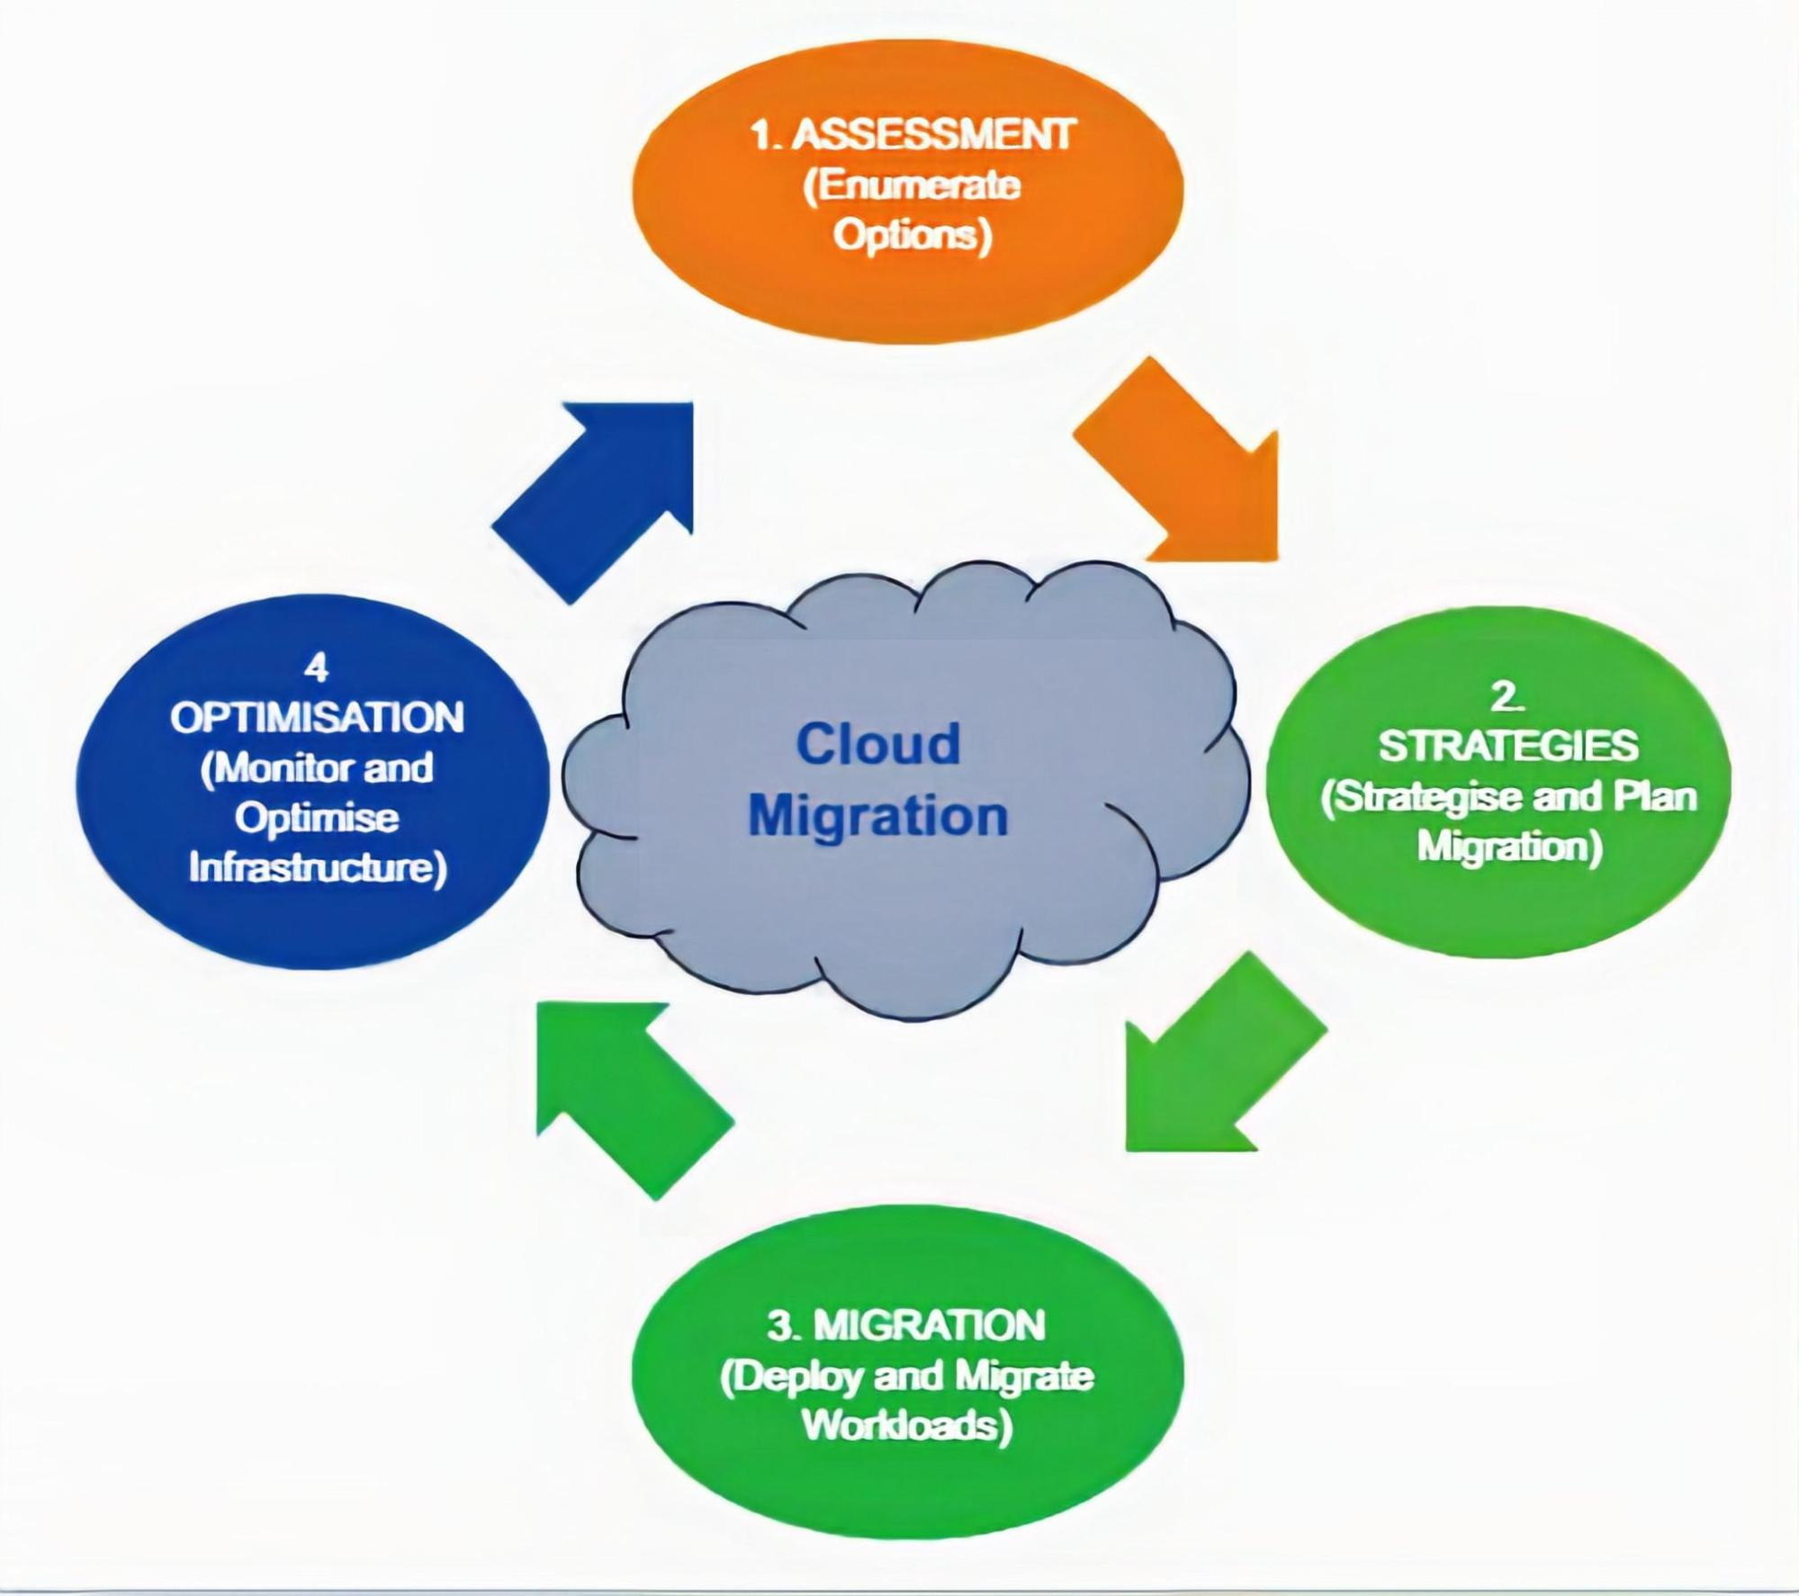
Introduction : Understanding the Benefits of and Strategies for Migration to the AWS Cloud
In today's rapidly evolving digital landscape, embracing cloud migration is pivotal for organizations aiming to enhance operational efficiency, scalability, and cost-effectiveness. Throughout this presentation, we will delve into the pivotal benefits and strategic approaches associated with migrating to the AWS Cloud. Let's explore the transformative potential of AWS cloud migration and the strategic options available for a successful transition.

Slide 4
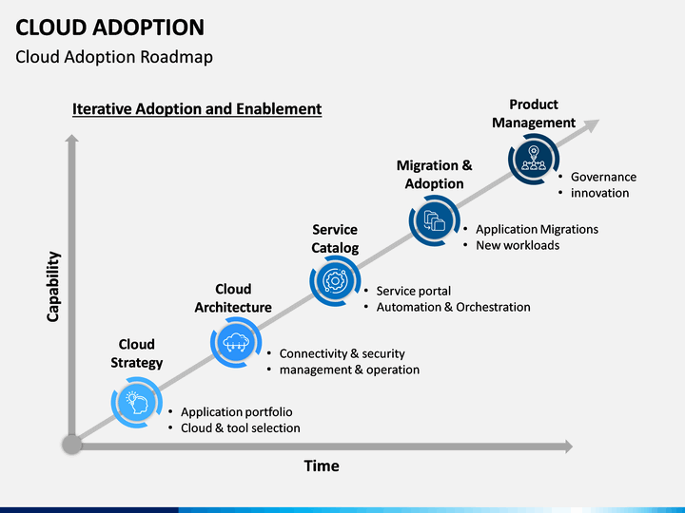
Cloud Adoption Strategies
Cloud adoption strategies encompass a range of approaches relevant for organizations aiming to transition to the AWS Cloud. These strategies include "rehosting" or "lift and shift," "refactoring," "re-architecting," "rebuilding," "replacing," and "retaining" solutions. Each strategy offers unique benefits and considerations, empowering businesses to make informed decisions when considering migration to the AWS Cloud.

Slide 5
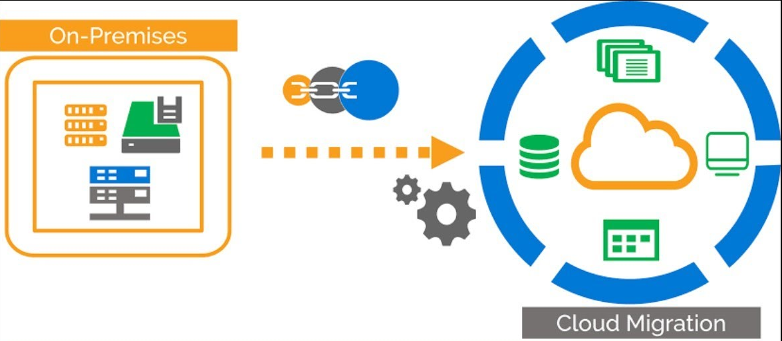
Resources to Support the Cloud Migration Journey
As organizations embark on the cloud migration journey, a multitude of resources and support mechanisms are available within the AWS ecosystem. AWS provides a comprehensive suite of migration tools and services, including the AWS Migration Hub, which offers a centralized platform for tracking and managing migrations. Additionally, AWS Database Migration Service and AWS Server Migration Service facilitate seamless database and server migrations. These resources collectively empower organizations to execute successful and efficient cloud migrations.

Slide 6
Understanding the Benefits of the AWS Cloud Adoption Framework (AWS CAF)
The AWS Cloud Adoption Framework (AWS CAF) serves as a strategic guide for organizations, navigating the complexities of cloud adoption. By embracing the AWS CAF, organizations stand to benefit from reduced business risk, improved environmental, social, and governance (ESG) performance, increased revenue, and heightened operational efficiency. Real-world case studies and examples demonstrate the positive impact of AWS CAF adoption, showcasing its transformative role in implementing cloud solutions effectively.

Slide 7
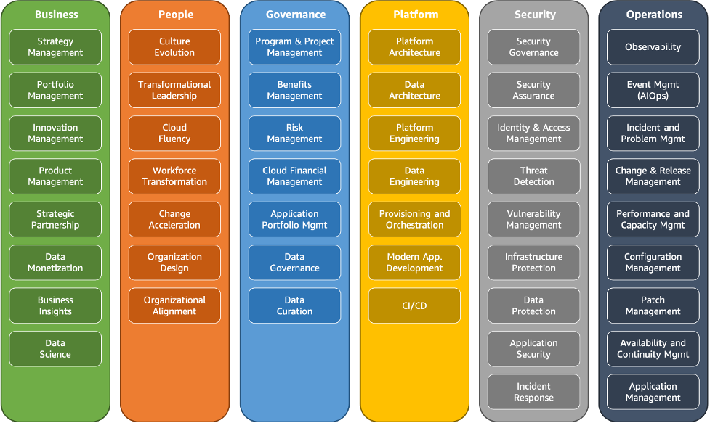

Slide 8
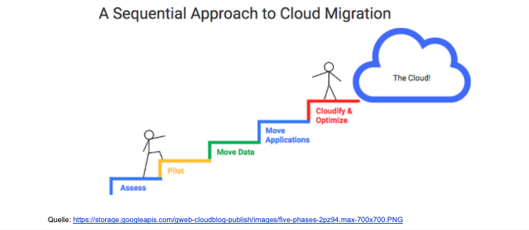
Identifying Appropriate Migration Strategies
In the context of AWS cloud migration, identifying suitable migration strategies is critical for a successful transition. Strategies such as database replication and the utilization of AWS Snowball are pivotal for minimizing disruption and optimizing the migration process. Organizations must prioritize understanding the nuances of these strategies and align them with specific business objectives to achieve successful AWS cloud migration outcomes.

Slide 9

Conclusion
Embracing AWS cloud migration can lead to transformative outcomes, offering organizations unparalleled scalability, cost efficiency, and technological agility. As you consider the strategic significance of migrating to the AWS Cloud, dive deeper into the resources and strategies outlined in this presentation. Whether it's the AWS Migration Hub, AWS CAF, or migration strategies tailored to your specific needs, AWS presents a wealth of opportunities for organizations to thrive in the cloud.

Slide 10


